Slide 1
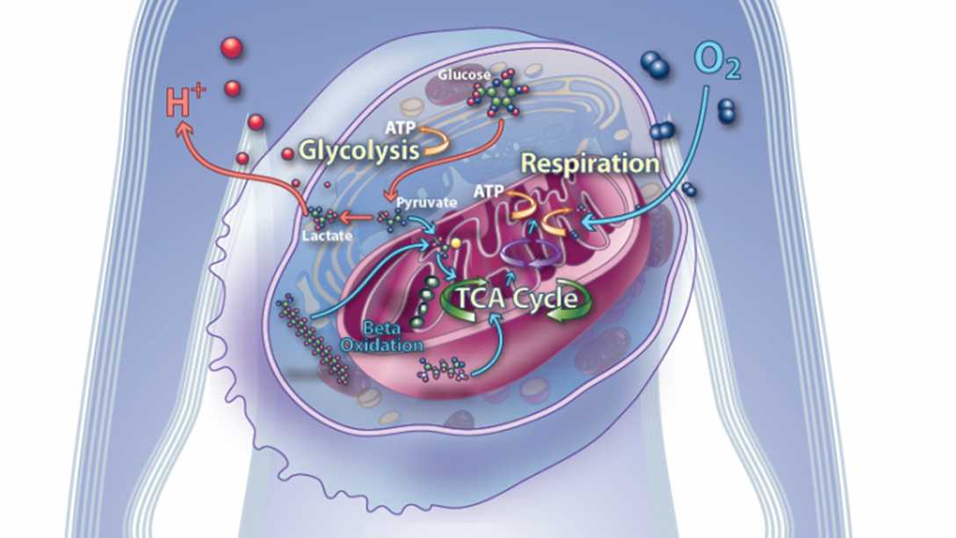
Cellular Respiration
AEHBY ATAR Human Biology

Slide 2
Review
Describe the features of nerve tissue.
Draw an example of connective tissue.
Name two organs from the digestive system.
Which organelle is responsible for cellular respiration?
Name two mechanisms for the transport of glucose across the cell membrane.

Slide 3

Learning Intentions
cellular respiration occurs, in different locations in the cytosol and mitochondria, to catabolise organic compounds, aerobically or anaerobically, to store energy in the form of adenosine triphosphate (ATP) for efficient metabolism

Slide 4
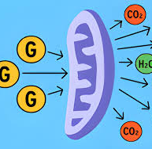
Success Criteria
Identify the location for aerobic and anerobic parts of cellular respiration
Compare the amount of ATP produced in aerobic and anaerobic respiration
Identify the inputs and outputs (byproducts) of glycolysis, the citric acid cycle and electron transport chain

Slide 5
Cellular respiration
cells convert food (glucose) into energy
in a series of enzyme activated steps
some using oxygen (aerobic) in the mitochondria
and some without (anaerobic)and in the cytoplasm

Slide 6
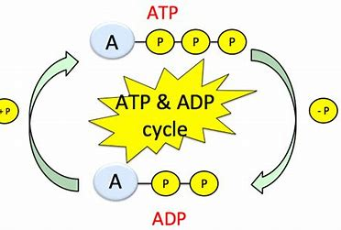
ADP and ATP
The ‘currency’ of energy in cells
Adenosine triphosphate
/diphosphate

Slide 7
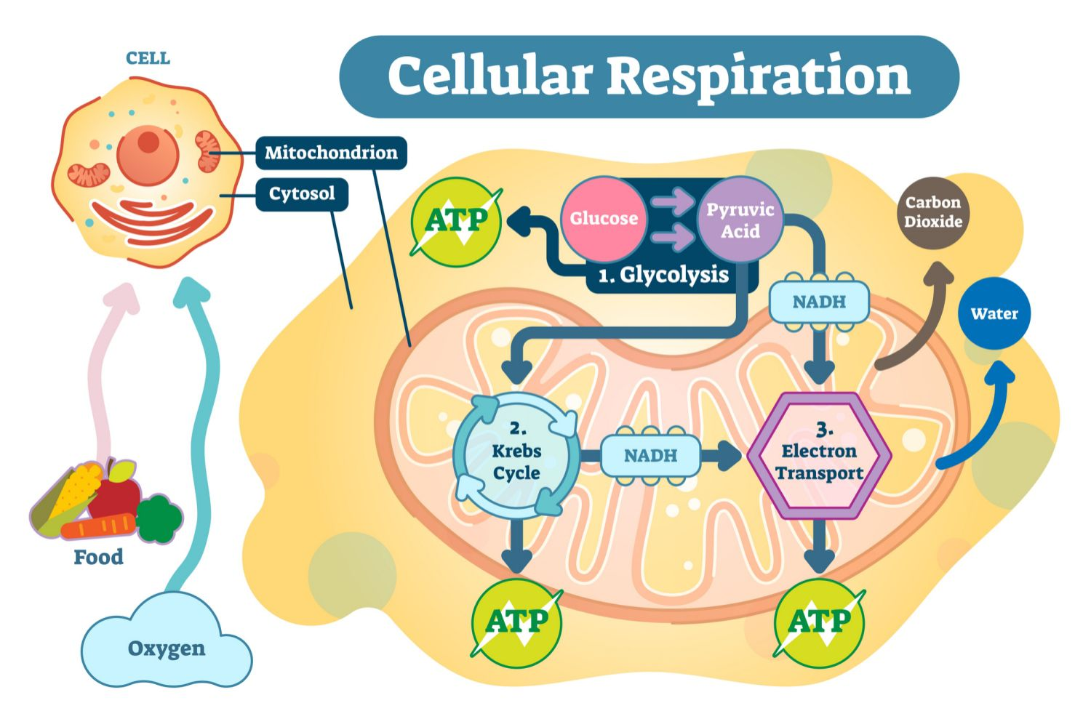

Slide 8
Step 1: Glycolysis
Glucose → Pyruvate (converted to lactic acid)
Anaerobic
Cytosol
Produces 2 ATP per cycle and 2 NADH

Slide 10
Step 2: Citric acid (Kreb’s) Cycle
Pyruvate converted to Acetyl CoA → NADH
Anaerobic
Mitochondria
Produces 2 ATP and 2 CO₂

Slide 12
Step 3: Electron transport chain (oxidative phosphorylation)
NADH → Carbon dioxide and water
Aerobic
Mitochondria
Up to 34 ATP per original glucose molecule

Slide 13
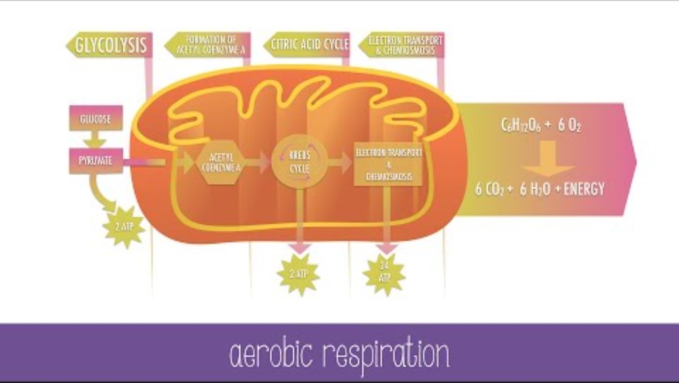

Slide 14
Questions
Write an overall equation for aerobic respiration
In which form is chemical energy used in the cell?
List the three steps of cellular respiration and for each, identify their location within the cell.
What are the byproducts of anaerobic respiration in the cell?
What are the benefits of aerobic respiration in the mitochondria?
Where are the enzymes for the citric acid cycle and electron transport chain located?

Slide 15
Success Criteria
Identify the location for aerobic and anerobic parts of cellular respiration
Compare the amount of ATP produced in aerobic and anaerobic respiration
Identify the inputs and outputs (byproducts) of glycolysis, the citric acid cycle and electron transport chain

